Slide 1

Lunch & Learn Play: The Super-Awesome Game
An XNA 4.0 Game by Peter Hoang

Slide 2
Welcome
Purpose:
I wanted to learn how to use the XNA framework
I like writing games
Learning:
What is the XNA 4.0 framework?
Common game engine design
Game’s source code examples
Playing:
About the game
How to play
Controls

Slide 3
Part 1: The Boring Learning Part
What is XNA?
Game Engine Architecture
My source code

Slide 4
XNA 4.0 Framework
Cross-platform
Windows Phone
Xbox 360 console
Windows PC
Based on the .NET Framework 4
C#
Visual Studio 2010 (intellisense)
Widely used
Lots of documentation and resources

Slide 5
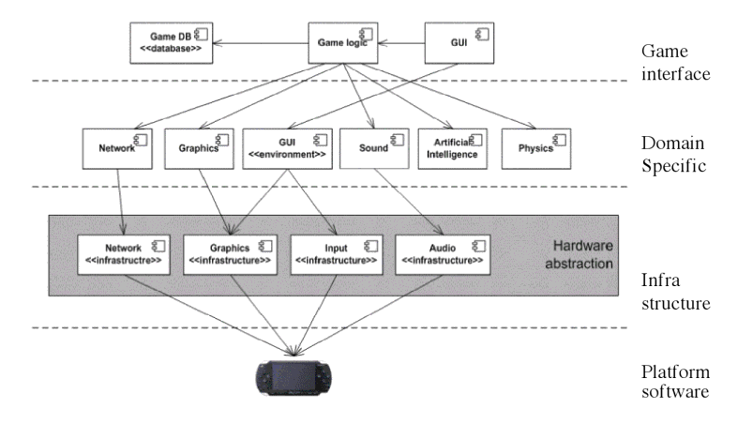
Game Engine Architecture

Slide 6
Popular Game Engines
FlatRedBall
XNA-based
Cocos2D
Unity
Game Maker
Unreal Engine
AAA

Slide 7
Source Code @ github
https://peterhoang@github.com/peterhoang/Super-Duper-Game.git

Slide 8
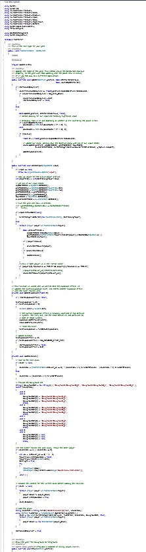
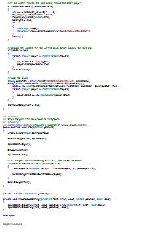
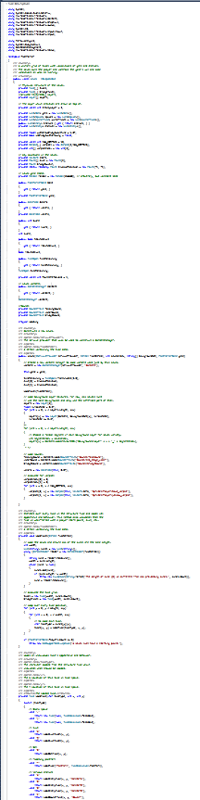
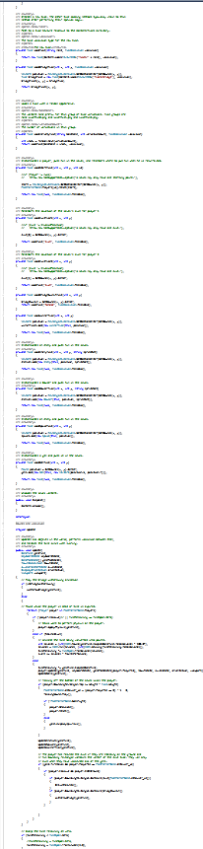
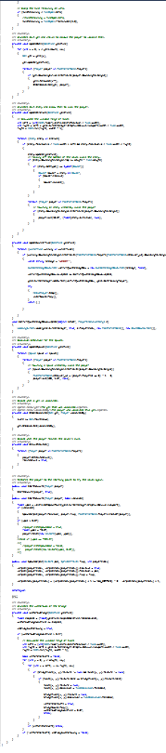
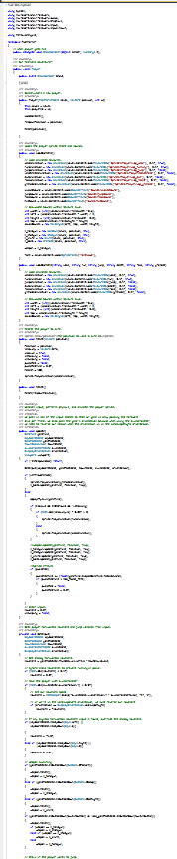
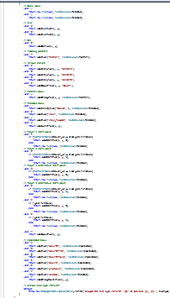
Source Code Sample

Slide 9
Act II: The Fun Part
About the game
How to play
Controls

Slide 10
About the Game
I wanted to create a simple and fun game while learning the XNA 4.0 Framework
Hint Hint
Inspired by a game called Nidhogg, an indie sword fighting game
So I can work on Windows Phone or equivalent projects

Slide 11




Rules (are meant to be broken)
It’s a two-player game. One player is blue the other is yellow.
There’s always only one attacker and one defender. The roles swap depending on the outcome of a fight.
The goal is to reach the last level. A colored arrow will point you the way.

Slide 12



Rules (cont’d)
As an attacker, you must go in the direction of your colored arrow while fighting the defender. You become a defender if you are defeated.
As a defender, you must defeat the attacker and prevent him from reaching the end of the level. You become the attacker if you defeat your opponent.
The game ends when the attacker reaches the last level.

Slide 13

The player who reaches the last level wins

Slide 14

…and the other player…

Slide 15
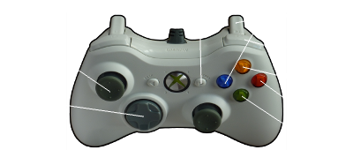
Controls

